Slide 1
Custom Controls and Forms
Programming – Introduction to C#
Last modified 12/12/16 by Alex Mackay

Slide 2
Contents
Varieties of Custom Controls
Composite Controls
Extended Controls
Custom Controls

Slide 3
Varieties of Custom Controls
Composite controls
A collection of controls contained in a common container
Extended controls
Inherit from any existing control to extend functionality
Custom controls
Created from scratch, specify your own painting
Notes:
You can develop and implement new controls in a few different ways.
Composite controls are collections of Windows Forms controls contained in a common container.
This is very much like a template of grouped controls we can place in to forms.
Composite controls hold all the functionality associated with each of the Windows Forms controls that they contain. These composite controls also provide a great deal of default keyboard handling functionality with no extra development effort required on out part.
Extended controls are controls that we derive from any existing Windows Forms control. They are created using inheritance, and so will inherit all the functionality of the base control.
We can then extend the functionality of the control by adding custom properties, methods, or other features.
We can also override the control’s paint logic to control its appearance.
Finally, Custom controls are controls we write from scratch.
A great deal of the implementation of the control is left up to us to define, so while they afford us greater flexibility, they are also more complicated to write than either composite or extended controls.
To implement a custom control we must write our own OnPaint method, as well as any feature-specific code. We can even define the way messages are handled by the control.
We’ll take a look at each of these kinds of custom controls in the following slides.

Slide 4
Composite Controls
Inherits from the UserControl class
Provides keyboard routing for child components
Enables child controls to work as a group
Ensures child controls can receive focus
Easiest custom control to create
Package and reuse controls between applications
Notes:
A composite control is a collection of Windows Forms controls encapsulated in a common container.
This kind of control is sometimes called a user control.
The contained controls are called constituent controls.
For example, a composite control could be built to display customer address data from a database. This control could include a DataGridView control to display the database fields, a BindingSource to handle binding to a data source, and a BindingNavigator control to move through the records.
You could package and reuse the entire control from application to application.
To create a composite control, we need to drive a new class from the UserControl class.
The UserControl base class provides keyboard routing for child controls and enables child controls to work as a group. The base class also ensures that child components can receive the focus.

Slide 5
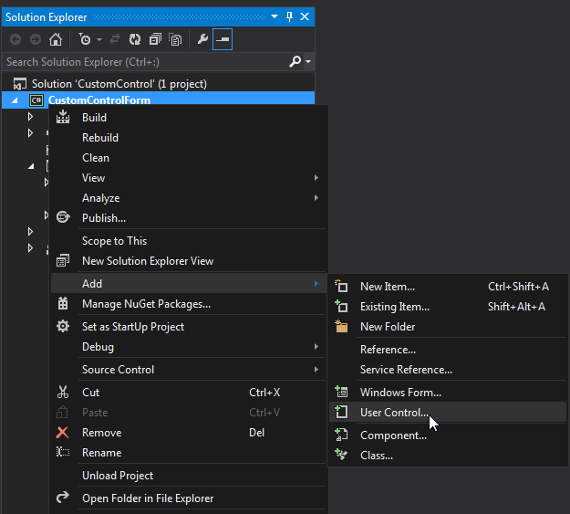
Composite Controls
Create a Windows Forms project
On the Project menu, select Add User Control
Or select from the Project context menu
Notes:
All custom control samples are in the sample project “Custom Controls and Forms\Custom Control”

Slide 6
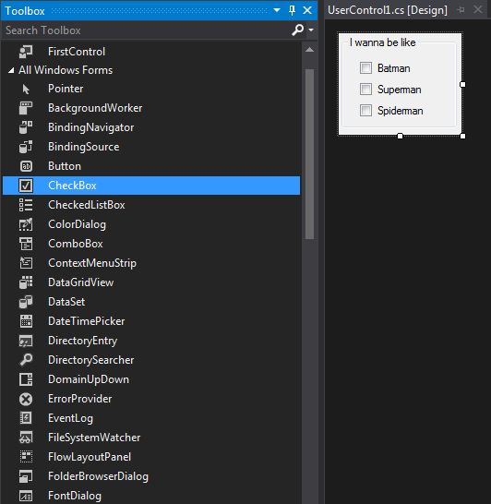
Composite Controls
Add controls from the Toolbox to the composite control
You must build the project for your control to appear in the Toolbox
Add the composite control to the Form

Slide 7
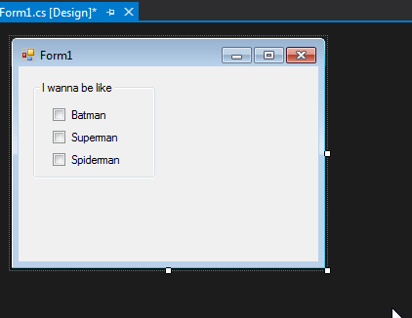
Composite Controls

Slide 8
Extended Controls
Inherit from an existing control
Retain and extend functionality
Can override paint logic for custom appearance
Use this method when:
The needed functionality is mostly identical to an existing control
Don’t need a custom GUI, or
Want a new GUI for an existing control
Notes:
You can derive an inherited control from any existing Windows Forms control.
With this approach, you can retain all of the inherent functionality of a Windows Forms control, and then extend that functionality by adding custom properties, methods, or other features.
With this option, you can override the base control's paint logic, and then extend its user interface by changing its appearance.
In some controls, you can also add a custom appearance to the graphical user interface of your control by overriding the OnPaint method of the base class.
For an extended button that tracks clicks, you can override the OnPaint method to call the base implementation of OnPaint, and then draw the click count in one corner of the Button control's client area.
Inherit from a Windows Forms control if:
Most of the functionality you need is already identical to an existing Windows Forms control.
You do not need a custom graphical user interface, or
you want to design a new graphical user interface for an existing control.

Slide 9
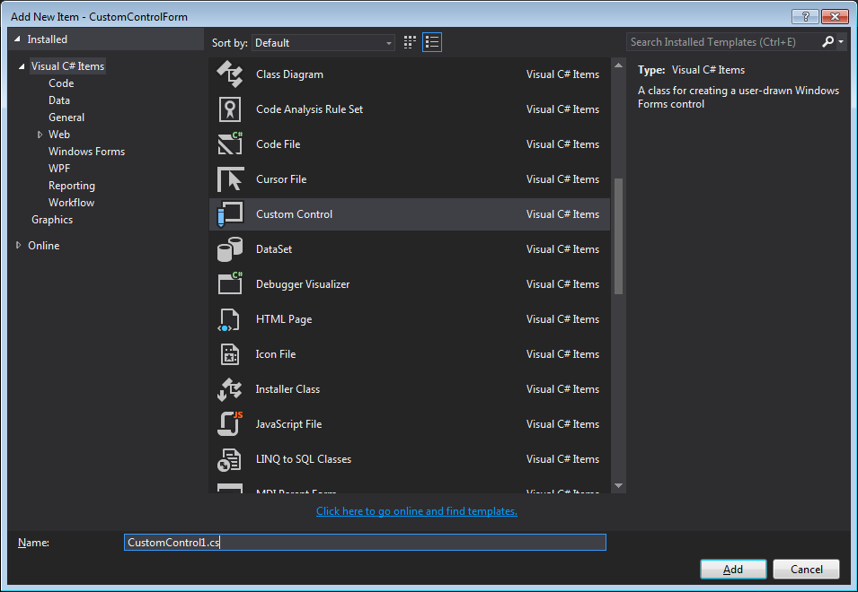
Extended Controls
Create a Windows Forms project
On the Project menu, select Add New Item
Or select from the Project context menu
In the Add New Item dialog, select Custom Control
Notes:
1. Create a new Windows Forms Application project.
2. From the Project menu, choose Add New Item.
The Add New Item dialog box appears.
In the Add New Item dialog box, double-click Custom Control.
3. A new custom control is added to your project.

Slide 10
Extended Controls
Open CustomControl1.cs in the Code editor
Locate the class declaration
Change the base class to the control you want to inherit from
Eg. Button
Implement custom methods, properties, drawing

Slide 11
Extended Controls
public partial class CustomControl1 : System.Windows.Forms.Button
{
int clickCount = 0;
public CustomControl1()
{
InitializeComponent();
}
protected override void OnClick(EventArgs e)
{
base.OnClick(e);
clickCount++;
}
protected override void OnPaint(PaintEventArgs pe)
{
base.OnPaint(pe);
Font drawFont = new Font("Arial", 8);
SolidBrush drawBrush = new SolidBrush(Color.Black);
pe.Graphics.DrawString(clickCount.ToString(), drawFont, drawBrush, Size.Width - 20, Size.Height - 20);
}
}
Notes:
This code will place a counter at the top-right of the button that counts how many times the button has been clicked.
To implement this, we override the OnClick and OnPaint events and extend the functionality of the base control

Slide 12
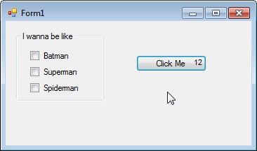
Extended Controls
Notes:
This is what our control looks like when added to a form.

Slide 13
Custom Controls
Created essentially from scratch
Inherit from the Control class
Greater flexibility, can tailor control to exact needs
Must write code for the OnPaint event
Use a Custom Control if:
Want to provide a custom graphical representation
Implement custom functionality not available in standard controls
Notes:
Another way to create a control is to create one substantially from the beginning by inheriting from Control.
The Control class provides all of the basic functionality required by controls, including mouse and keyboard handling events, but no control-specific functionality or graphical interface.
Creating a control by inheriting from the Control class requires much more thought and effort than inheriting from UserControl or an existing Windows Forms control.
Because a great deal of implementation is left for you, your control can have greater flexibility than a composite or extended control, and you can tailor your control to suit your exact needs.
To implement a custom control, you must write code for the OnPaint event of the control, as well as any feature-specific code you need.
You can also override the WndProc method and handle windows messages directly.
An example of a custom control is a clock control that duplicates the appearance and behaviour of an analogue clock.
Custom painting is invoked to cause the hands of the clock to move in response to Tick events from an internal Timer component.
Inherit from the Control class if:
You want to provide a custom graphical representation of your control.
You need to implement custom functionality that is not available through standard controls.

Slide 14
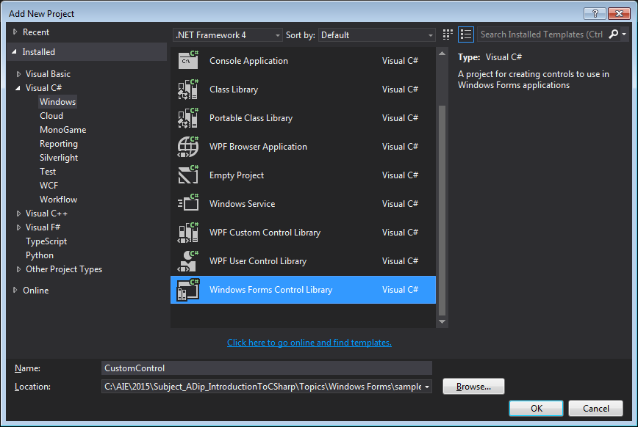
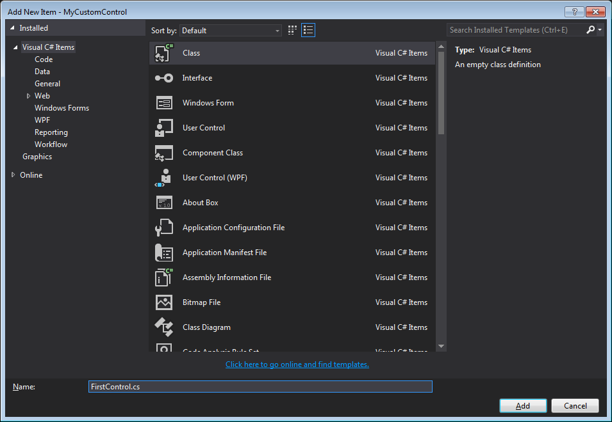
Custom Controls
Add a New Project to your solution
Create a Windows Forms Control Library
Remove the User Control and add a New Class derived from Control

Slide 15
Custom Controls
Add an image to the project
This is the background for the Analogue clock
Set properties to ‘Embedded Resource’, and ‘Do not copy’
Code your custom control

Slide 16
using System;
using System.Collections.Generic;
using System.Linq;
using System.Text;
using System.Drawing;
using System.Windows.Forms;
using System.ComponentModel;
namespace CustomControl {
public class FirstControl:System.Windows.Forms.Control {
private Bitmap bitmap;
public FirstControl() {
DoubleBuffered = true;
ClockTimer.Tick += ClockTimer_Tick;
ClockTimer.Enabled = true;
ClockTimer.Interval = 1;
ClockTimer.Start();
bitmap = new Bitmap(
GetType().Module.Assembly.GetManifestResourceStream(
"CustomControl.jellyfish_trans.png"));
}
private void ClockTimer_Tick(object sender, EventArgs e) {
Refresh();
}
private Timer ClockTimer = new Timer();
private bool showSeconds = true;
[
Category("Show Seconds"),
Description("Show the second hand.")
]
public bool ShowSeconds {
get {
return showSeconds;
}
set {
showSeconds = value;
Invalidate();
}
}
protected override void OnPaint(PaintEventArgs e) {
base.OnPaint(e);
e.Graphics.DrawImage(bitmap, 0, 0, this.Width, this.Height);
float radius = (Size.Width / 2);
PointF origin = new PointF(
Size.Width / 2, Size.Height / 2);
if(showSeconds == true)
e.Graphics.DrawLine(Pens.Black, origin,
PointOnCircle(radius,
DateTime.Now.Second * 6f, origin));
e.Graphics.DrawLine(Pens.Black, origin,
PointOnCircle(radius * 0.75f,
DateTime.Now.Minute * 6f, origin));
e.Graphics.DrawLine(Pens.Black, origin,
PointOnCircle(radius * 0.50f,
DateTime.Now.Hour * 30f, origin));
}
private PointF PointOnCircle(float radius, float angleInDegrees,
PointF origin)
{
float x = (float)(radius * Math.Cos((angleInDegrees - 90f) *
Math.PI / 180F)) + origin.X;
float y = (float)(radius * Math.Sin((angleInDegrees - 90f) *
Math.PI / 180F)) + origin.Y;
return new PointF(x, y);
}
}
}
Notes:
Some of this is not obvious and I had to remove the comments to get all the code onto one page.
Open the sample for the fully commented code.
The tough part for me was figuring out how to load the png from the .dll file (since the image is packed in the .dll as an embedded resource).
You need to put the namespace before the image filename.
Basically, we’ve set up a timer to refresh the control every second.
In the OnPaint method we draw the background image and then the hands of the clock.
We can set whether or not to display the second, minute or hour hands based on the value of the properties. These 3 properties can be set from the Forms Designer.
(Note that only the ShowSeconds property is shown here because the other two – minutes and hours – are identical and there wasn’t room to show them)

Slide 17
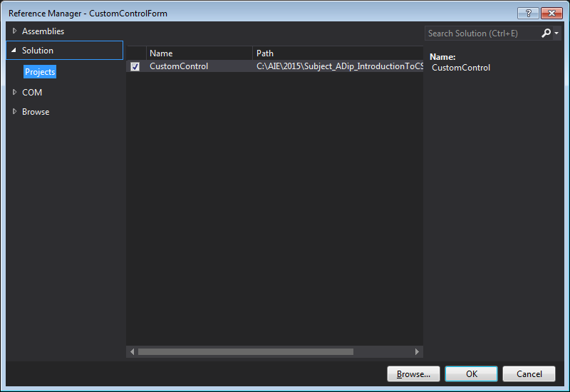
Custom Controls
Build the project
Add a reference in your project containing the form to the library containing the new control
From the Project menu select Add Reference
Add the new control to your form

Slide 18
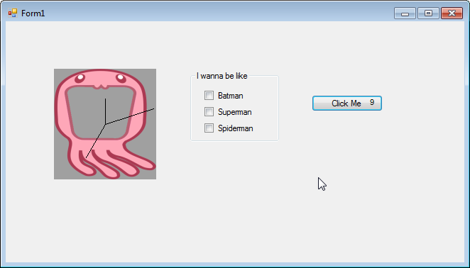
Custom Controls

Slide 19
Summary
Composite Controls group standard controls together in one container
Easiest to make
Extended Controls inherit from an existing control and extend functionality
Custom Controls provide greatest flexibility, but most implementation done by us
Must override OnPaint method

Slide 20
Further Reading
Microsoft Developer Network. 2016. Varieties of Custom Controls. [ONLINE] Available at: https://msdn.microsoft.com/en-us/library/ms171725(v=vs.110).aspx. [Accessed 12 December 16]
Microsoft Developer Network. 2016. How to: Author Composite Controls. [ONLINE] Available at: https://msdn.microsoft.com/en-us/library/3sf86w5h(v=vs.110). [Accessed 12 December 16]
Microsoft Developer Network. 2016. How to: Inherit from Existing Windows Forms Controls. [ONLINE] Available at: https://msdn.microsoft.com/en-us/library/7h62478z(v=vs.110).aspx. [Accessed 12 December 16]
Microsoft Developer Network. 2016. How to: Develop a Simple Windows Forms Control. [ONLINE] Available at: https://msdn.microsoft.com/en-us/library/649xahhe(v=vs.110).aspx. [Accessed 12 December 16]

